Slide 1
SQL PROJECT

Slide 2
INTRODUCTION
The IPL 2024 Auction SQL Project is designed to analyze and manage the player data for the upcoming Tata Indian Premier League (IPL) auction.
This project leverages a structured database to store, query, and manipulate information about players, enabling efficient data handling and insightful analysis for teams, analysts, and enthusiasts.
The dataset includes a detailed profile of each player, covering attributes such as demographics, playing history, skillset, previous IPL teams, and their auction-specific details like capped/uncapped status and reserve price. By employing SQL, this project provides a platform for answering complex queries, generating statistical insights, and exploring trends related to player selection, performance, and team strategies.

Slide 3

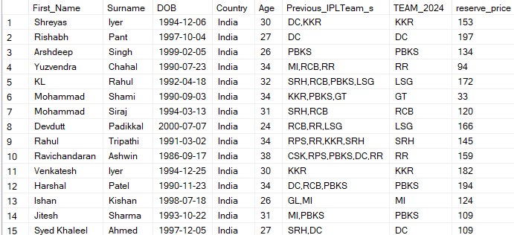
TATA IPL 2024
Question :
List all players from India in the auction
ANSWER:
The Total players are 355 and here are 15 players.

Slide 4
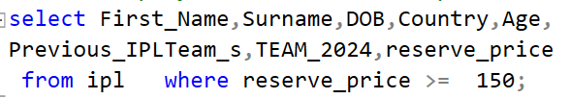
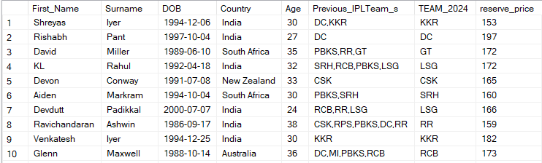
TATA IPL 2024
Question :
Find players with a reserve price above 150 Lakhs ?
ANSWER:
The Total players are 355 and here are 10 players.

Slide 5
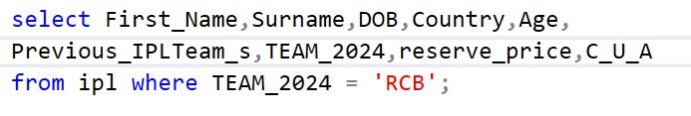
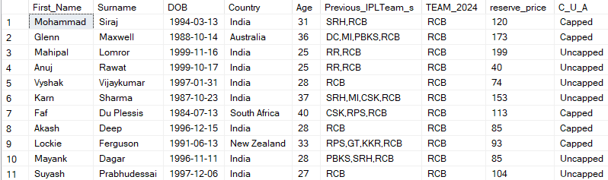
TATA IPL 2024
Question :
the names of players who represented "RCB" in 2024 ?
ANSWER:
The Total players
are 22 and here are 11 players.

Slide 6

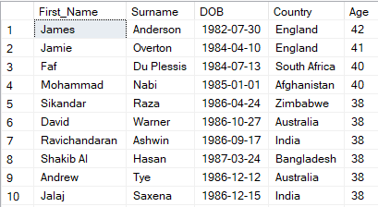
TATA IPL 2024
Question :
Identify the oldest player in the auction ?
ANSWER:
The oldest players
are James Anderson, Jamie Overton with the age of 42 & 41 and following

Slide 7

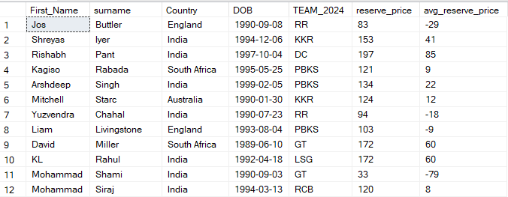
TATA IPL 2024
Question :
List all players along with the difference in their reserve price and the average reserve price ?
ANSWER:
The player with Highest average reserve price is Rishabh pant & David Miller

Slide 8

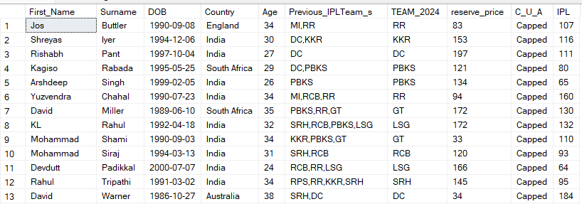
TATA IPL 2024
Question :
Find players who have played more than 50 ipl matches ?
ANSWER:
The player with Highest IPL Matches is Yuzvendra chahal & David Warner

Slide 9
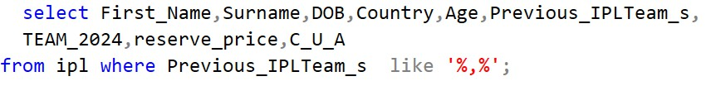
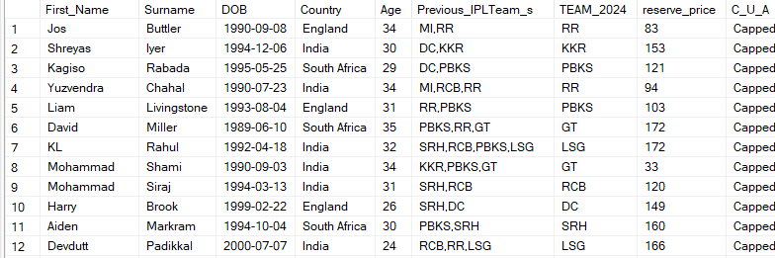
TATA IPL 2024
Question :
List all players who have been part of more than one IPL team ?
ANSWER:
The player who have been part of many teams are KL Rahul & Mohammed Shami

Slide 10
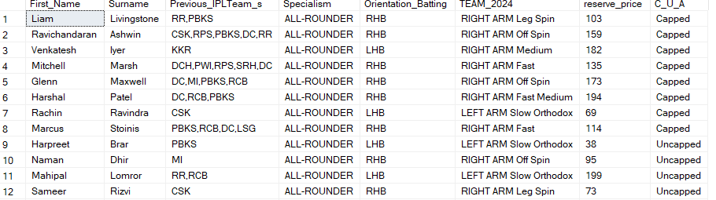
TATA IPL 2024
Question :
Retrieve players who are both batters and bowlers (dual specialism) ?
ANSWER:
The list of players who are
ALL-ROUNDER

Slide 11
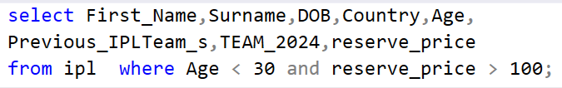
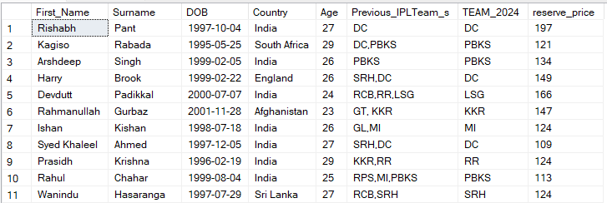
TATA IPL 2024
Question :
Find players who are younger than 30 years old and have a reserve price above 100 Lakhs ?
ANSWER:
The Highest reserve price player is Rishabh Pant and following

Slide 12
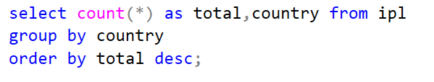
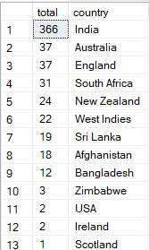
TATA IPL 2024
Question :
Retrieve the total number of players per country participating in the auction ?
ANSWER:
The most players from country is India, Australia, England and following

Slide 13
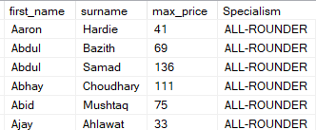
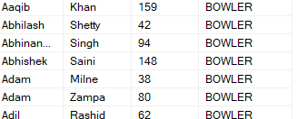
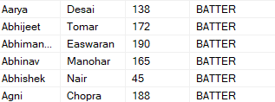
TATA IPL 2024
Question :
Find the player with the highest reserve price for each specialism ?
ANSWER:
The list of Players who has max reserve price from Batting, Bolling, ALL-ROUNDER

Slide 14
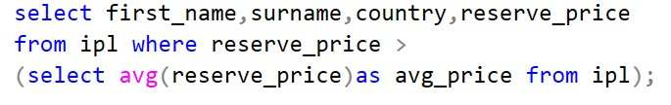
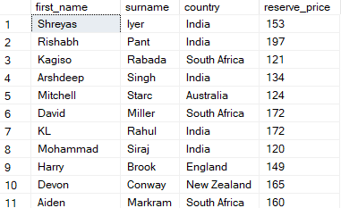
TATA IPL 2024
Question :
Find players whose reserve price is above the average reserve price ?
ANSWER:
The list of Players who has reserve price is above average price

Slide 15
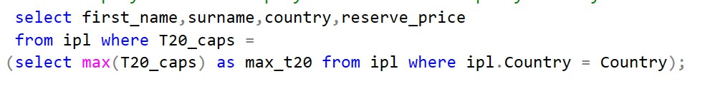

TATA IPL 2024
Question :
List players who have played the most T20 caps by country ?
ANSWER:
The plyers who have most T20 Caps are Mohammed Nabi, Shakib Al Hasan

Slide 16
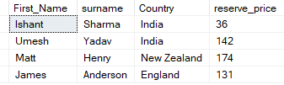
TATA IPL 2024
Question :
Retrieve details of players who have played more than 50 ODIs or more than 30 Tests but less than 20 T20 matches ?
ANSWER:
The list of players are

Slide 17
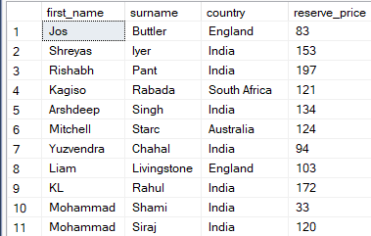
TATA IPL 2024
Question :
Find players born in the 1990s ?
ANSWER:
The list of players who has born in 1990s are

Slide 18
THANK YOU
Presented By Asjad Hussain

